Slide 1
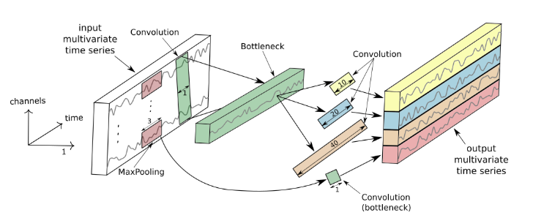
Convolutional Neural Network
Slides edited from Stanford + MIT Deep Learning in Life Sciences
http://cs231n.stanford.edu/slides/2019/cs231n_2019_lecture09.pdf

Slide 2
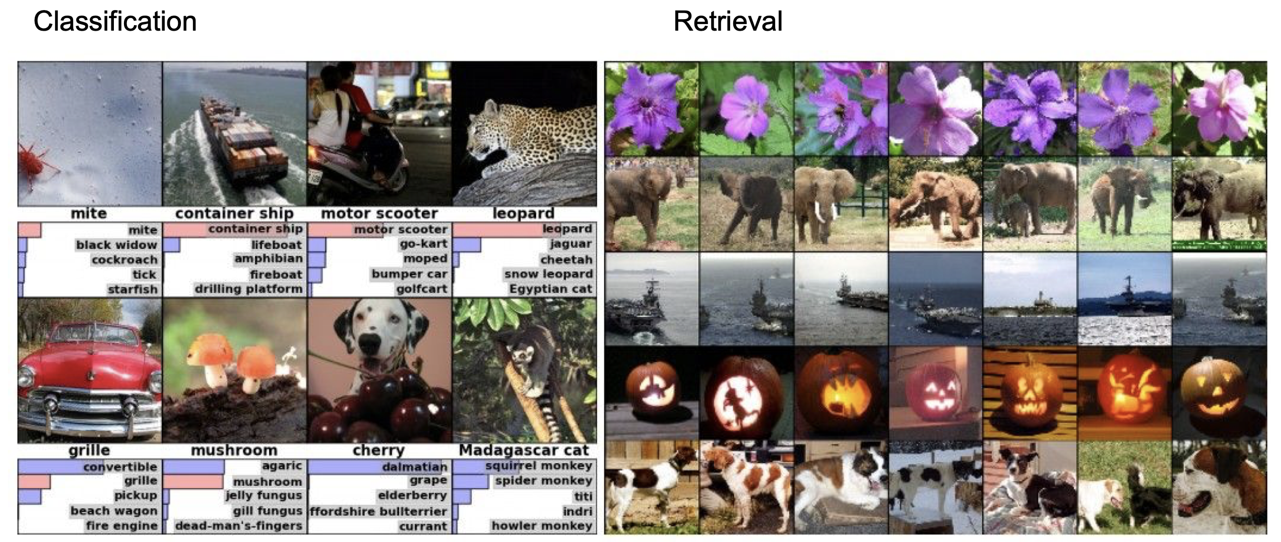
ConvNets are now used everywhere

Slide 3
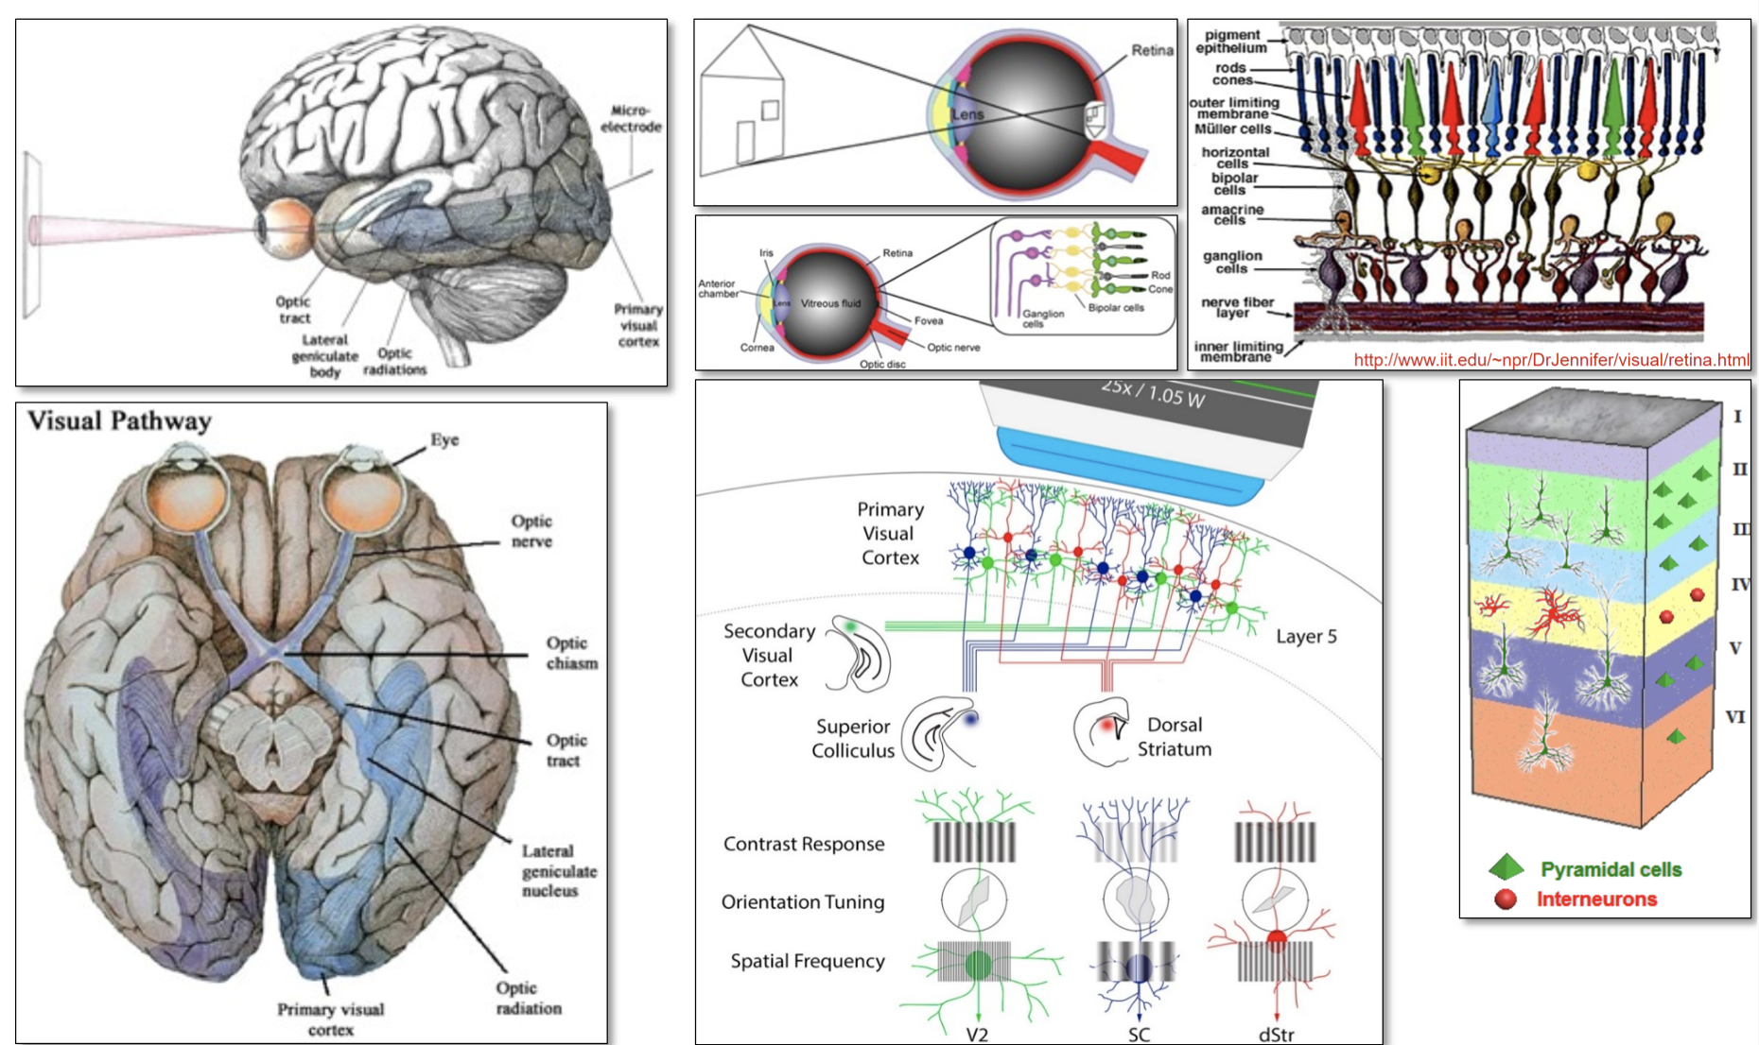
CNN and the human visual cortex

Slide 4
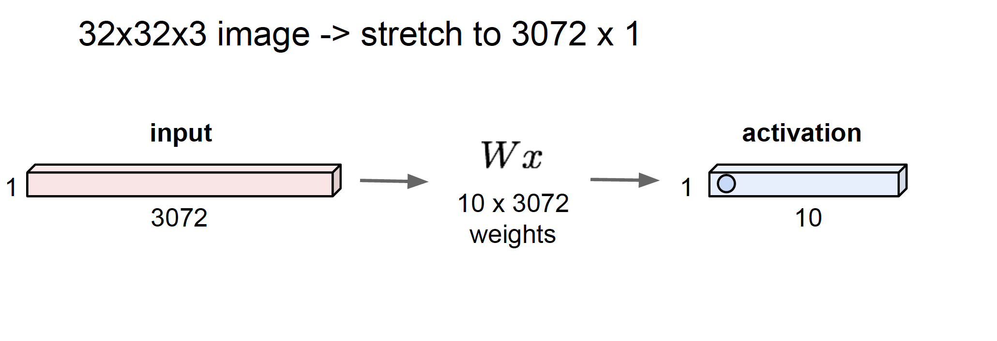
Fully Connected Layer

Slide 5
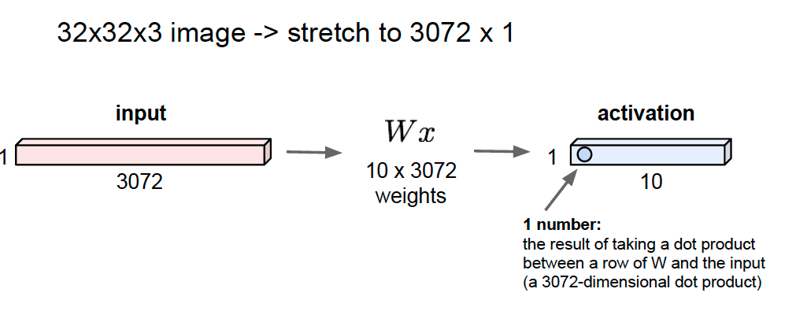
Fully Connected Layer

Slide 6
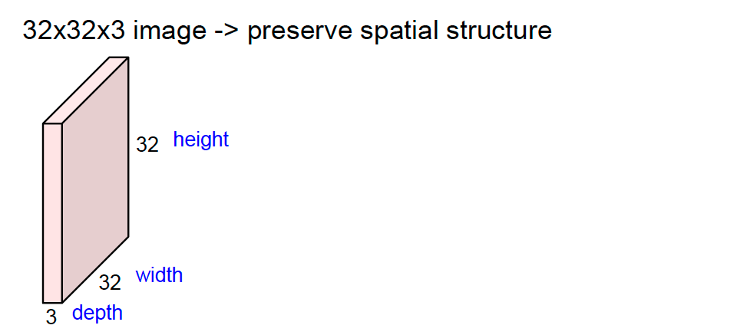
Convolution Layer

Slide 7
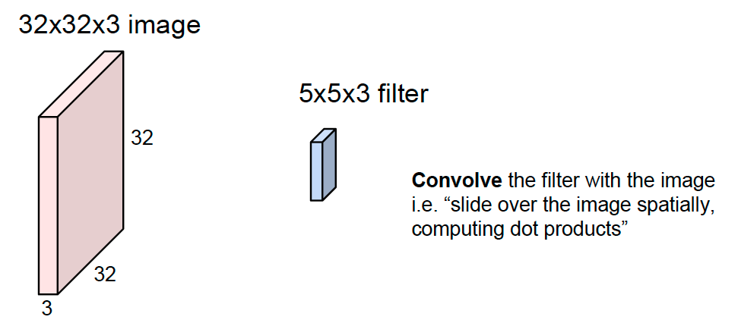
Convolution Layer
Filters always extend the full
depth of the input volume

Slide 8
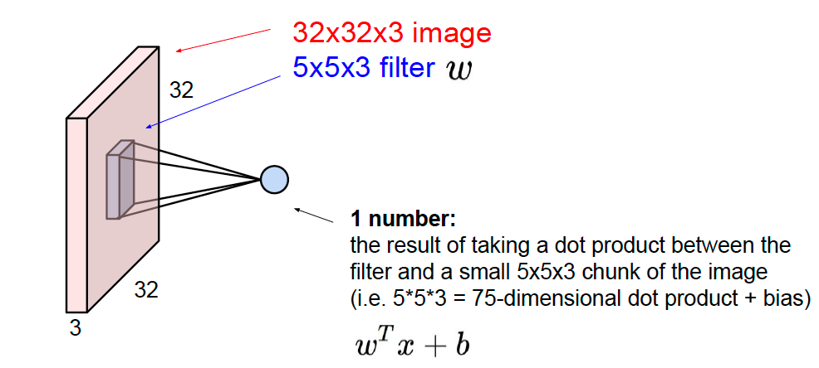
Convolution Layer

Slide 9
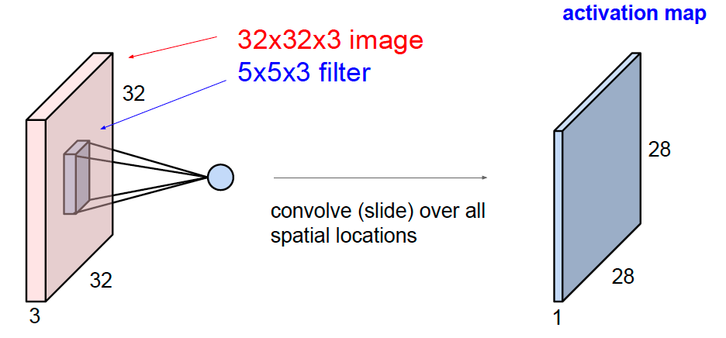
Convolution Layer

Slide 10
Convolution Layer
1 | 0 | 1
0 | 1 | 0
1 | 0 | 1
Convolution
Kernel / Filter

Slide 11
Convolution Layer

Slide 12
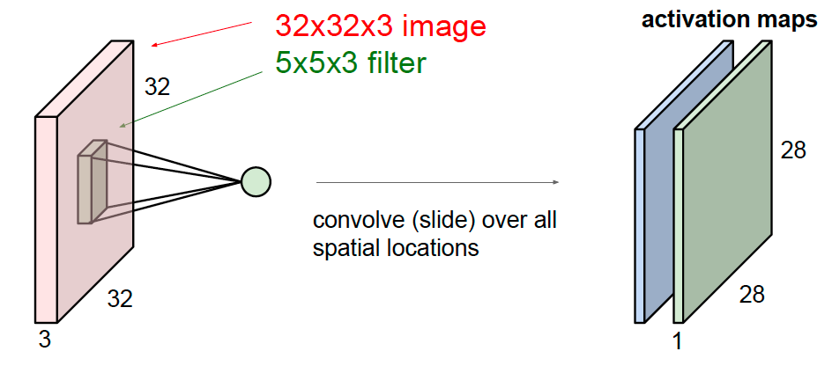
Convolution Layer

Slide 13
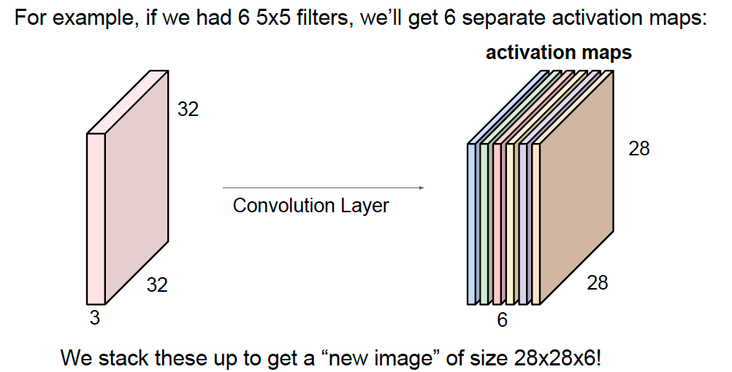
Convolution Layer

Slide 14
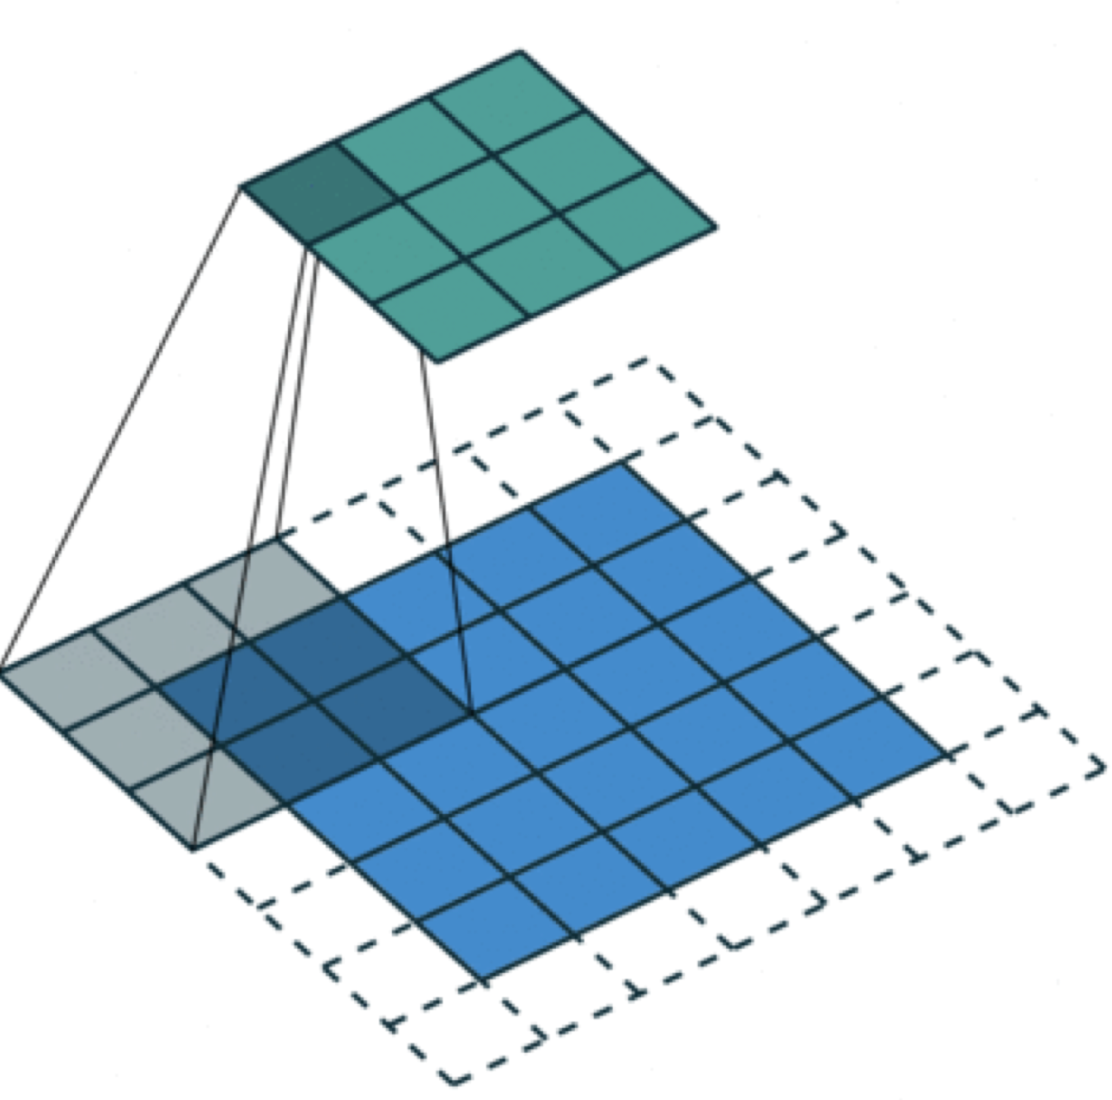
Feature Extraction with Convolution
Apply a set of weights – a filter – to extract local features
Use multiple filters to extract different features
Spatially share parameters of each filter

Slide 15
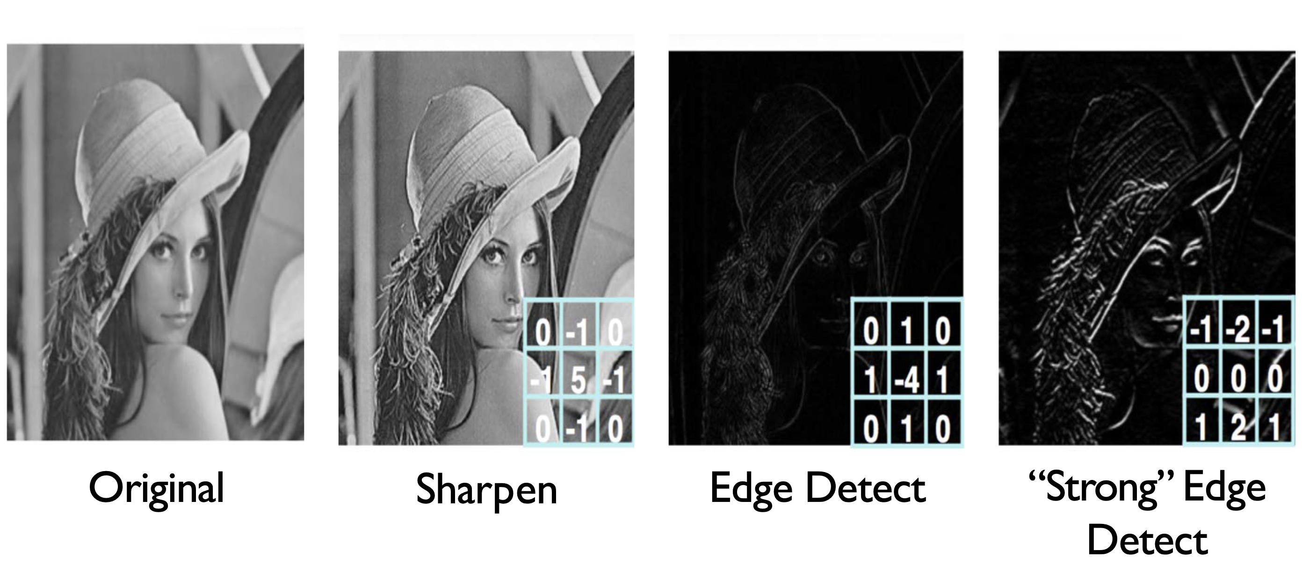
Feature Maps

Slide 16
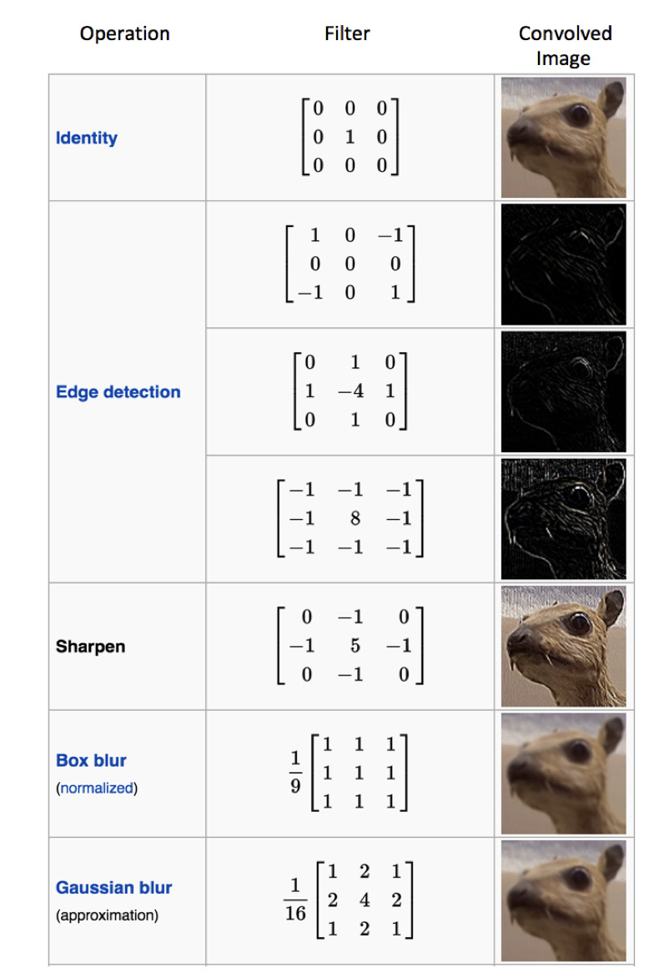

Slide 17
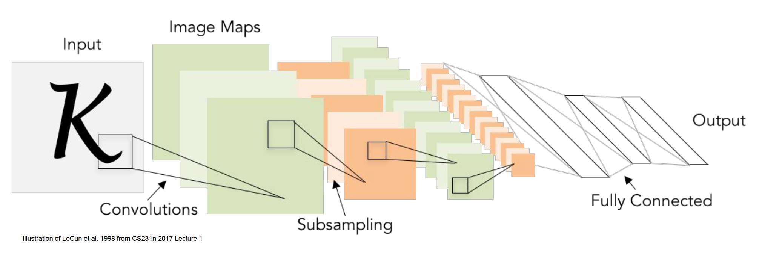
Convolutional Neural Network

Slide 18
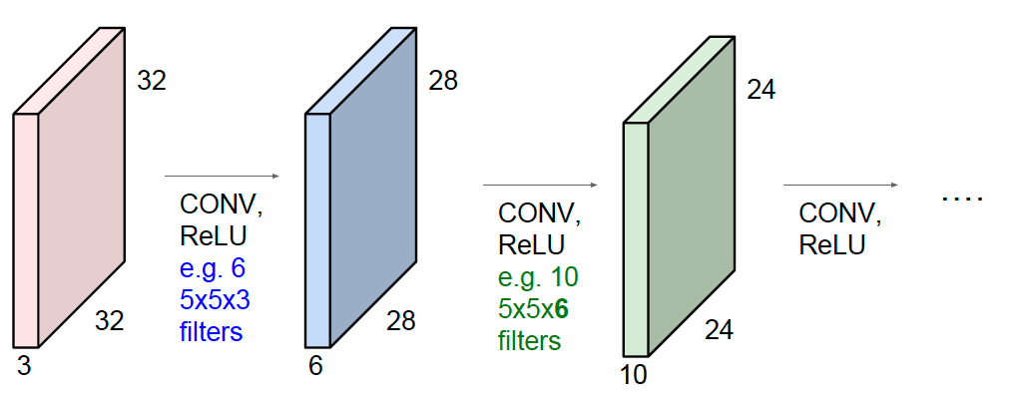
Convolutional Neural Network
CNN is a sequence of Conv Layers, interspersed with activation functions.
CNN shrinks volumes spatially.
E.g. 32x32 input convolved repeatedly with 5x5 filters! (32 -> 28 -> 24 ...).
Shrinking too fast is not good, doesn’t work well.
Notice the ReLU activation

Slide 19
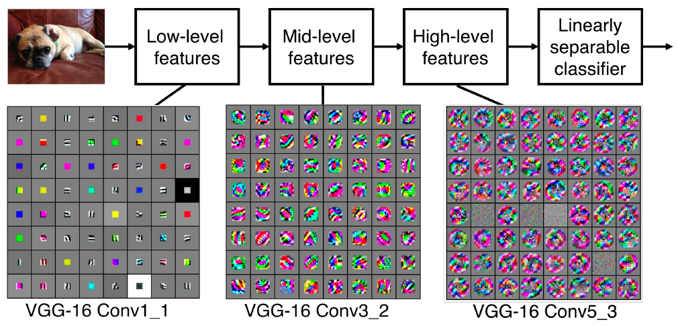
CNN for Image Classification

Slide 20
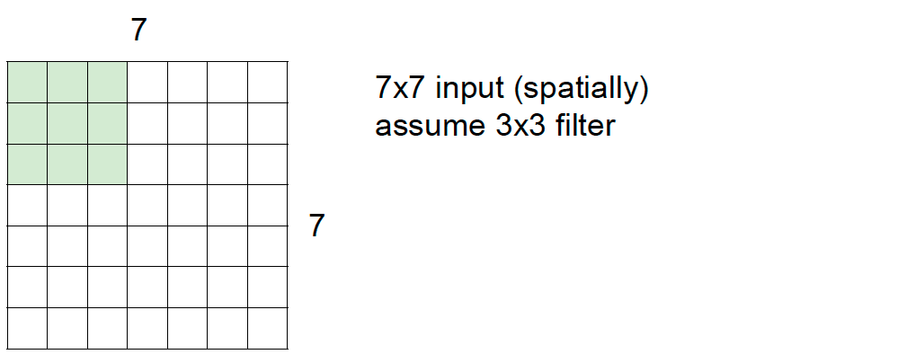
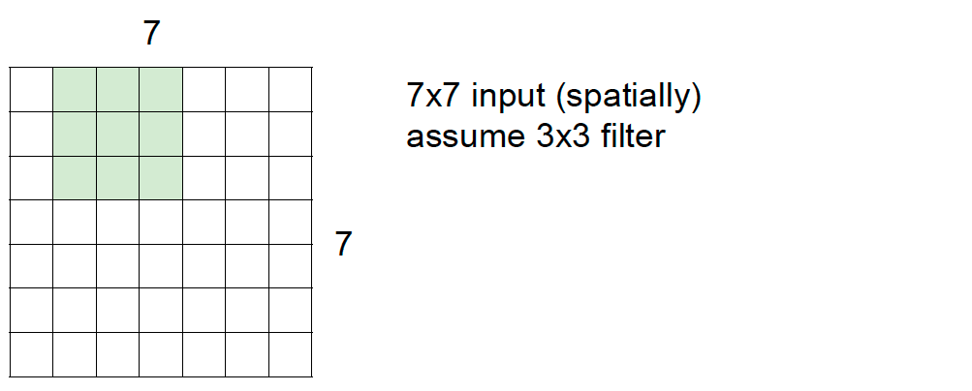
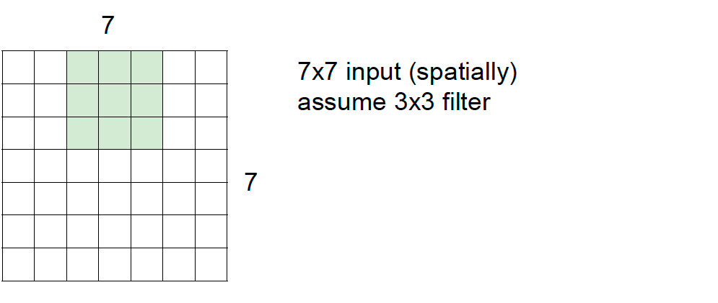
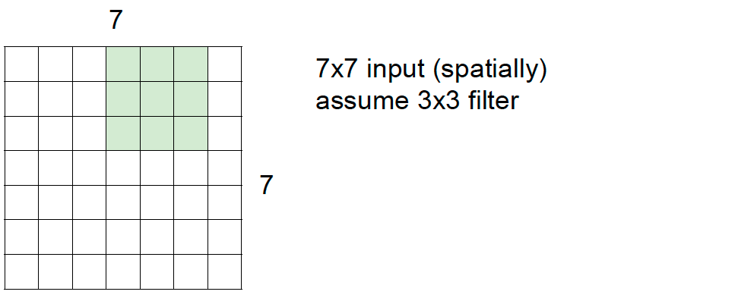
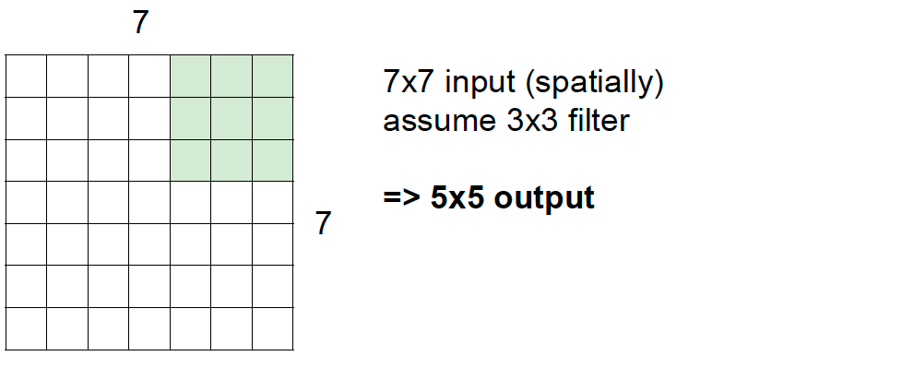
Stride

Slide 21
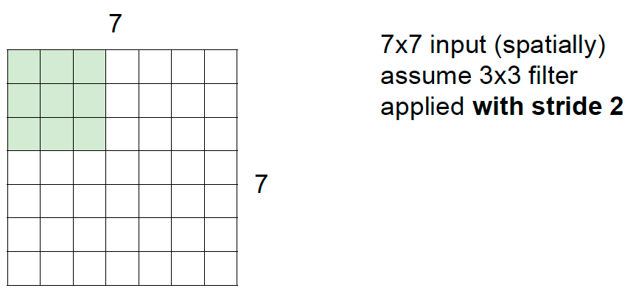
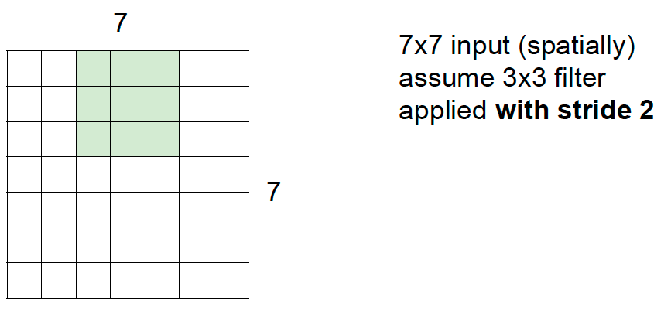
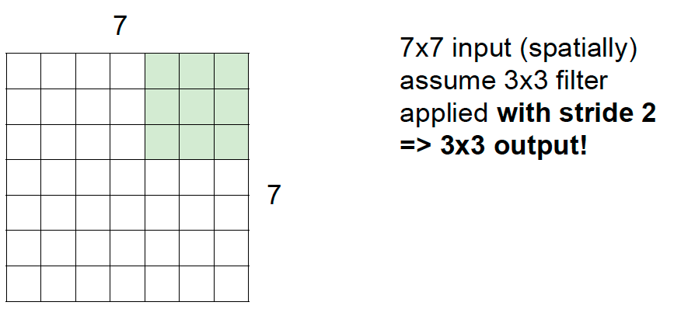
Stride

Slide 22
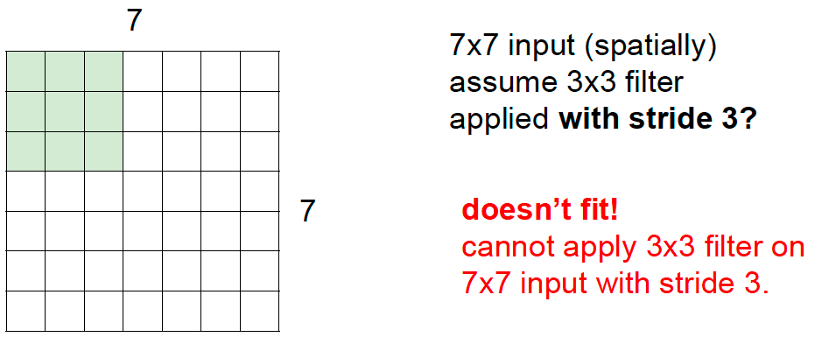
Stride

Slide 23
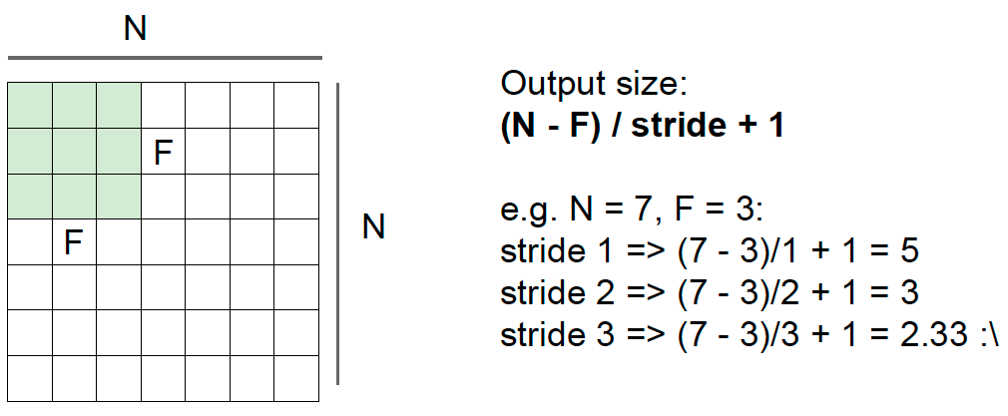
Stride

Slide 24
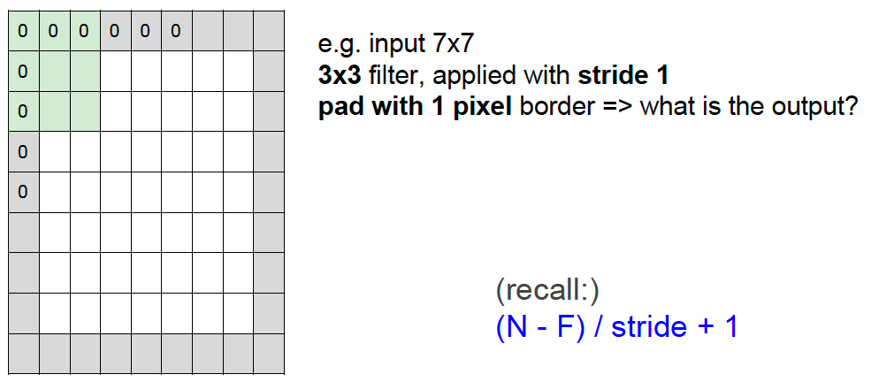
Padding
7x7 output!
In general, common to see CONV layers with stride 1, filters of size FxF, and zero-padding with (F-1)/2. (will preserve size spatially)
F = 3 => zero pad with 1 pixel
F = 5 => zero pad with 2 pixel
F = 7 => zero pad with 3 pixel

Slide 25
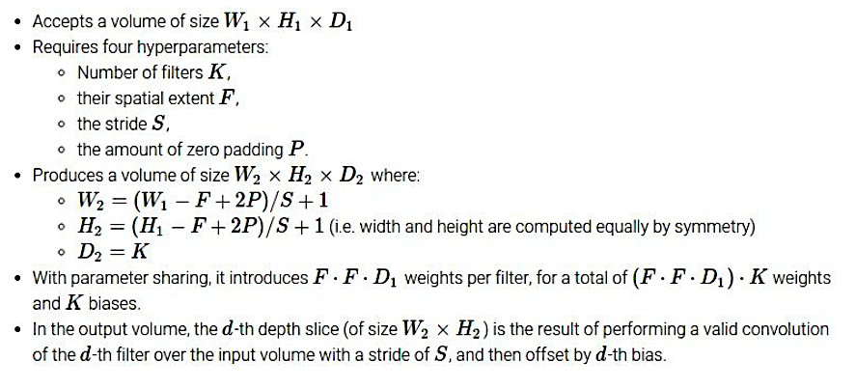
Convolution Summary

Slide 26
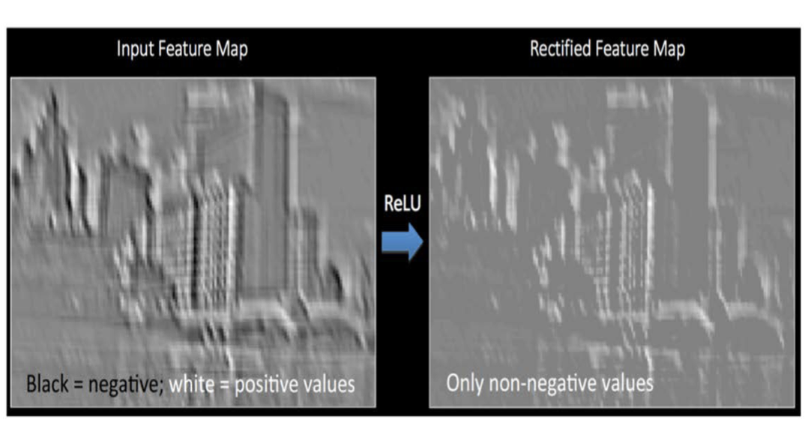
Activation after convolution
Apply after a convolution operation (i.e., after convolutional layers)
ReLU: pixel-by-pixel operation that replaces all negative values by zero.
Non-linear operation

Slide 27
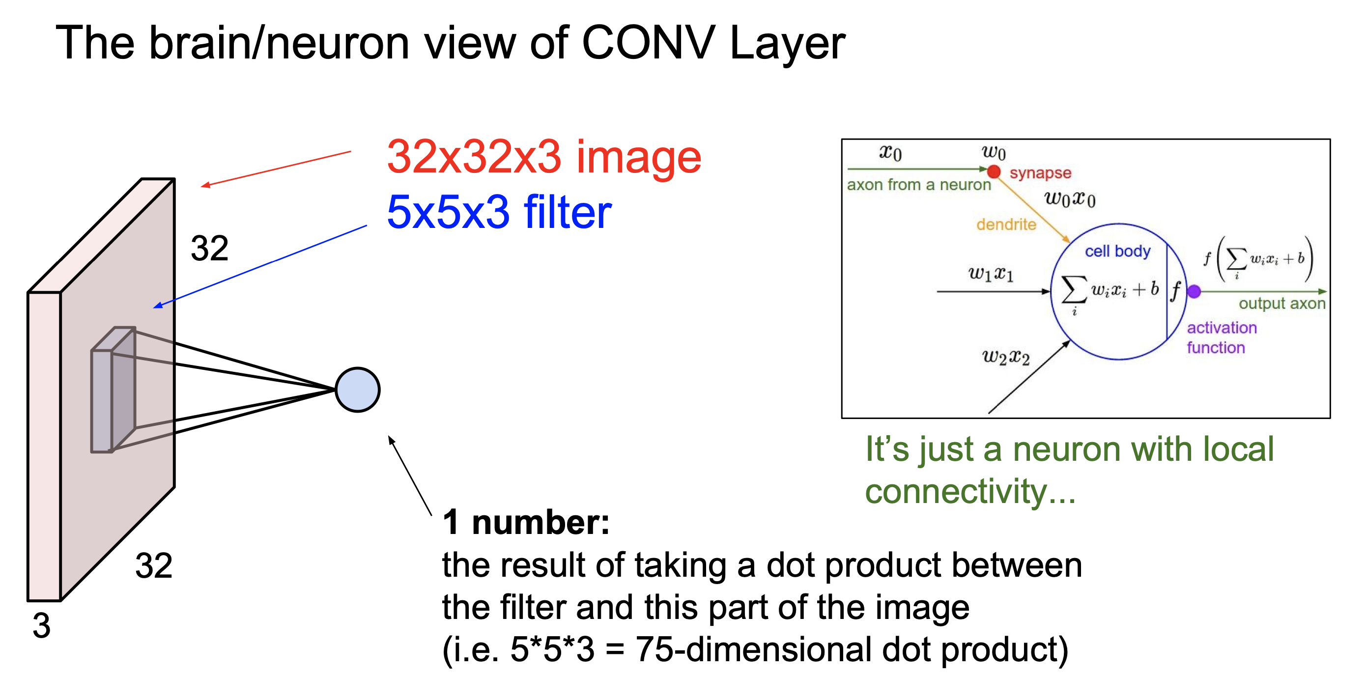

Slide 28
Parameter Sharing
Image
Kernel
Output
1 | 2 | 3
4 | 5 | 6
7 | 8 | 9
I | II
III | IV
A | B
C | D

Slide 29
Parameter Sharing
1
2
3
A
Image
Kernel
Output
4
B
1 | 2 | 3
4 | 5 | 6
7 | 8 | 9
I | II
III | IV
A | B
C | D
5
C
6
D
7
8
9

Slide 30
Parameter Sharing
1
I
2
II
3
A
Image
Kernel
Output
III
4
B
1 | 2 | 3
4 | 5 | 6
7 | 8 | 9
IV
I | II
III | IV
A | B
C | D
5
C
6
D
7
8
9

Slide 31
Parameter Sharing
1
2
I
3
II
A
Image
Kernel
Output
4
B
1 | 2 | 3
4 | 5 | 6
7 | 8 | 9
III
I | II
III | IV
A | B
C | D
5
IV
C
6
D
7
8
9

Slide 32
Parameter Sharing
1
2
3
A
Image
Kernel
Output
4
I
B
1 | 2 | 3
4 | 5 | 6
7 | 8 | 9
I | II
III | IV
A | B
C | D
5
II
C
6
D
III
7
IV
8
9

Slide 33
Parameter Sharing
1
2
3
A
Image
Kernel
Output
4
B
1 | 2 | 3
4 | 5 | 6
7 | 8 | 9
I | II
III | IV
A | B
C | D
5
I
C
II
6
D
7
III
8
IV
9

Slide 34
Parameter Sharing
1
2
3
A
Image
Kernel
Output
4
B
1 | 2 | 3
4 | 5 | 6
7 | 8 | 9
I | II
III | IV
A | B
C | D
5
C
6
D
7
8
9

Slide 35
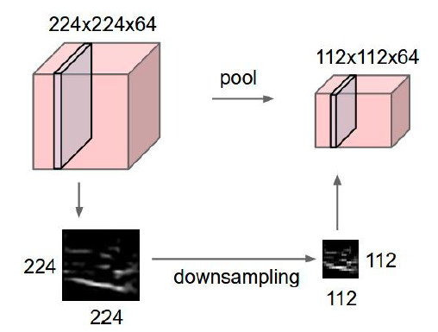
Pooling Layer
Makes the representations smaller and more manageable
Operates over each activation map independently

Slide 36
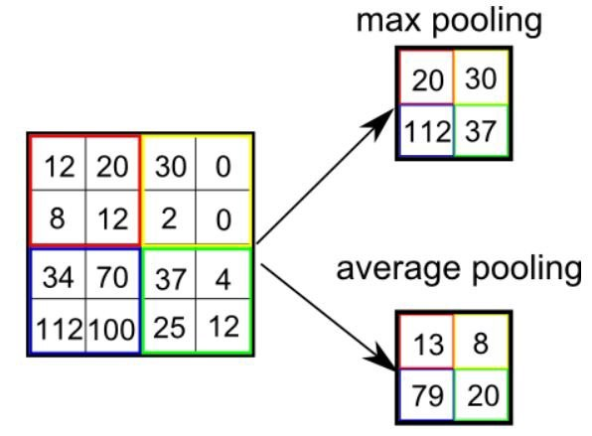
MaxPooling and AvgPoling

Slide 37
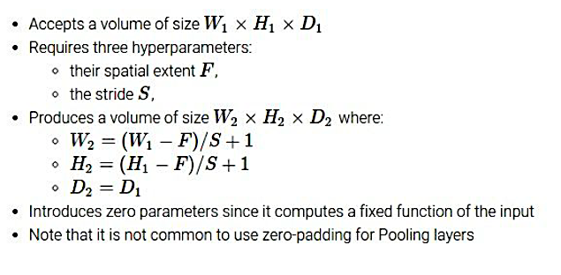
Pooling Summary

Slide 38
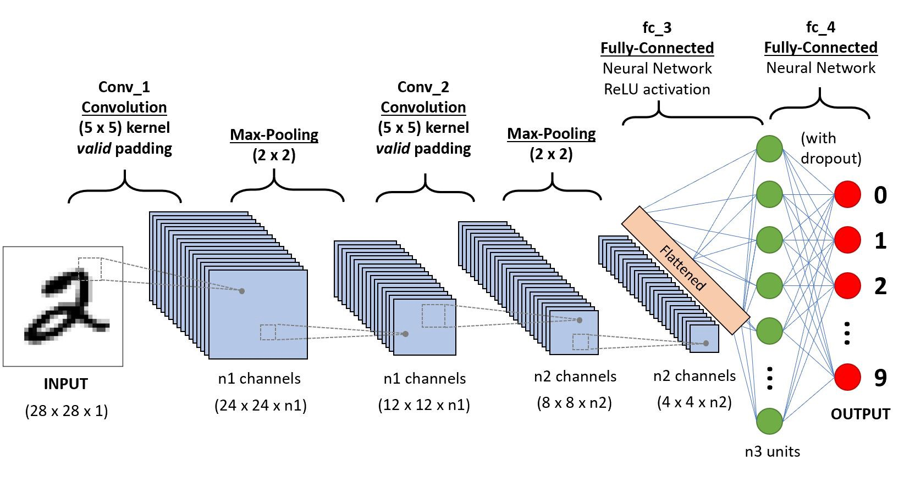
Example of CNN

Slide 39
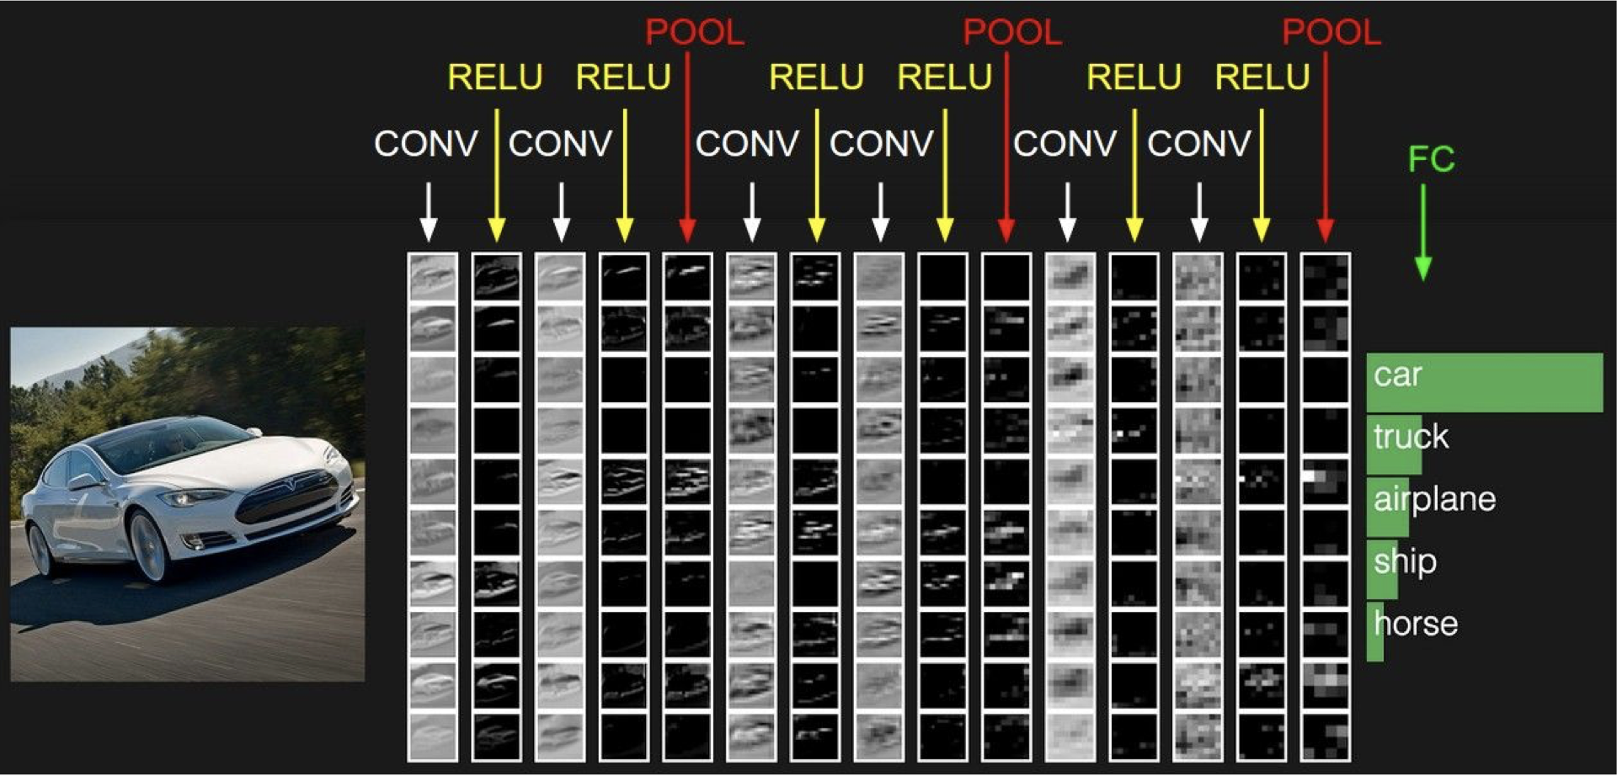
Example of CNN

Slide 40
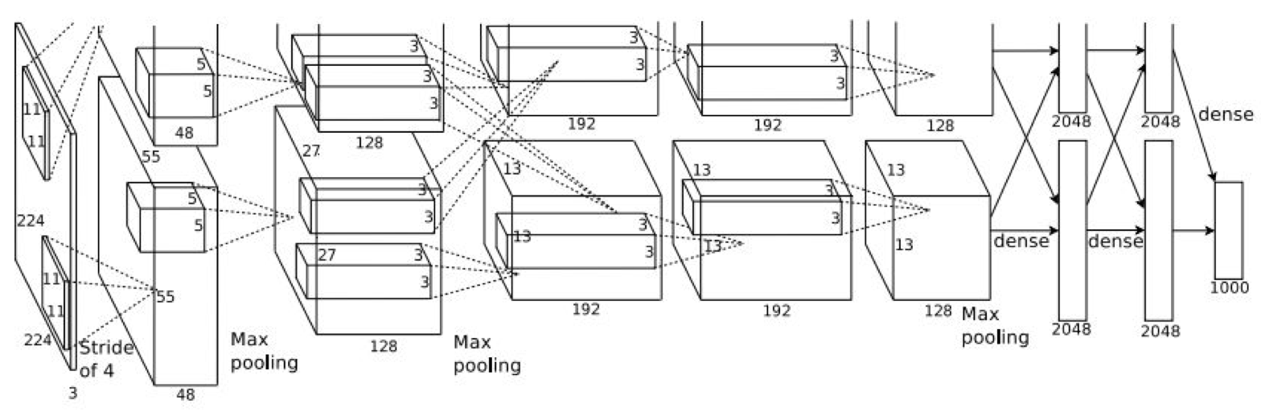
AlexNet [Krizhevsky et al. 2012]
Input: 227x227x3 images
First layer (CONV1): 96 11x11 filters applied at stride 4
Output volume size?
(227 -11)/4+1 = 226/4 + 1 = 55 Output :[55x55x96]
Total number of parameters?
(11*11*3)*96 = 35K

Slide 41
AlexNet [Krizhevsky et al. 2012]
Input: 227x227x3 images After CONV1: 55x55x96
Second layer (POOL1): 3x3 filters applied at stride 2
Output volume size?
(55 -3)/2+1 = 52/2 + 1 = 27 Output :[27x27x96]
Total number of parameters?
0!

Slide 42
AlexNet [Krizhevsky et al. 2012]
Full (simplified) AlexNet architecture: [227x227x3] INPUT [55x55x96] CONV1: 96 11x11 filters at stride 4, pad 0
[27x27x96] MAX POOL1: 3x3 filters at stride 2
[27x27x96] NORM1: Normalization layer [27x27x256] CONV2: 256 5x5 filters at stride 1, pad 2
[13x13x256] MAX POOL2: 3x3 filters at stride 2
[13x13x256] NORM2: Normalization layer
[13x13x384] CONV3: 384 3x3 filters at stride 1, pad 1
[13x13x384] CONV4: 384 3x3 filters at stride 1, pad 1
[13x13x256] CONV5: 256 3x3 filters at stride 1, pad 1
[6x6x256] MAX POOL3: 3x3 filters at stride 2 [4096] FC6: 4096 neurons [4096] FC7: 4096 neurons [1000] FC8: 1000 neurons (class scores)

